Slide 1

Classification of Tourism Reviews from Bengali Texts using Multinomial Naïve Bayes
Paper ID : 90
Authors: Suborno Deb Bappon, MD. Asif Iqbal
Department of Computer Science and Engineering,
Chittagong University of Engineering and Technology (CUET)
Presenter : Suborno Deb Bappon
IEEE ICCIT 2022 (Conference ID - 57492), 17-19 Dec. 2022, Cox’s Bazar, Bangladesh

Slide 2
Outline
Introduction
Motivation
Objectives
Challenges
Applications
Related Works
Corpus Analysis
Methodology
Experiment
Experimental Results
Error Analysis
Limitations
Future Improvements
Conclusion
References
Notes:
Here is the outline of our presentation

Slide 3

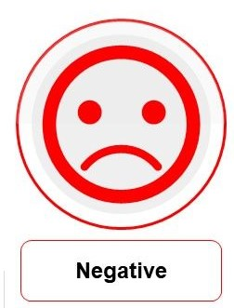
Introduction
Sentiment Analysis
Process of analyzing pieces of text for classifying sentiment from it.
Basic sentiment: 2 types- Positive and Negative.

Slide 4
Introduction (Cont.)
Develop a Machine Learning based framework
To classify two basic type of sentiments- positive and negative.
Sentiment
ল্যাপটপটি অনেক ভালো
এবং খুব তাড়াতাড়ি বুটিং
হচ্ছে
Positive

Slide 5
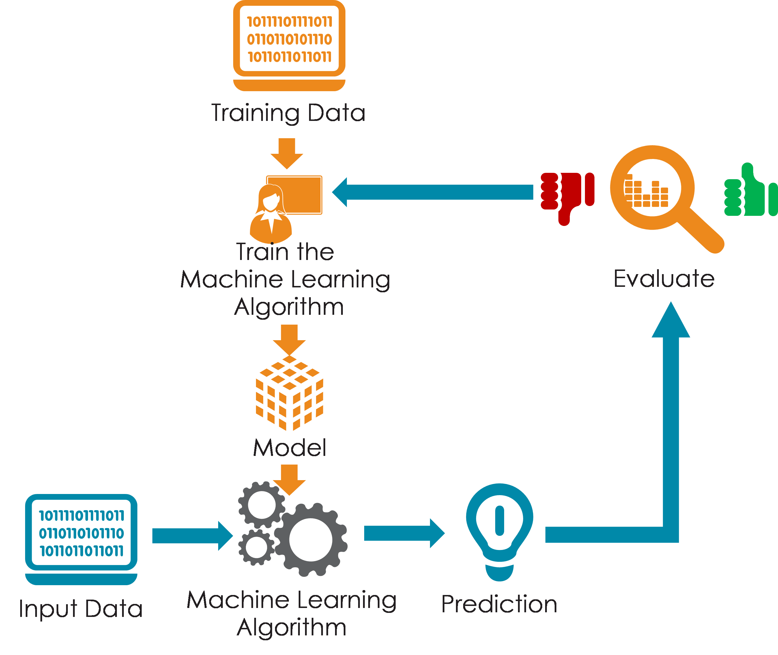
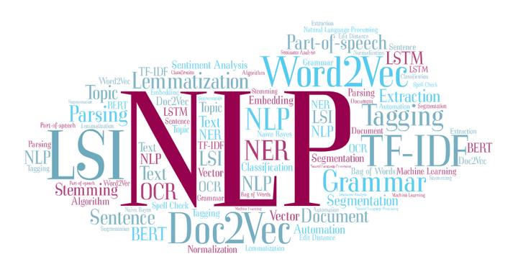
Introduction (Cont.)
Image Source : https://towardsdatascience.com/natural-language-processing-nlp-dont-reinvent-the-wheel-8cf3204383dd
https://7wdata.be/big-data/building-the-machine-learning-infrastructure/
Notes:
https://towardsdatascience.com/natural-language-processing-nlp-dont-reinvent-the-wheel-8cf3204383dd
https://www.ibm.com/cloud/learn/neural-networks
We are going to use, Natural Language Processing in combination with Deep Learning Techniques to solve the problem.

Slide 6
Motivation
Huge amount of Bengali Text Generation
Across various social platforms everyday.
Needs for Automation
Manually reading reviews is time consuming.
To better understand the consumer opinion.
Helps Tourism Companies and Authorities
To figure out new marketing strategies and make future decisions.
To assess tourist destination popularity.

Slide 7
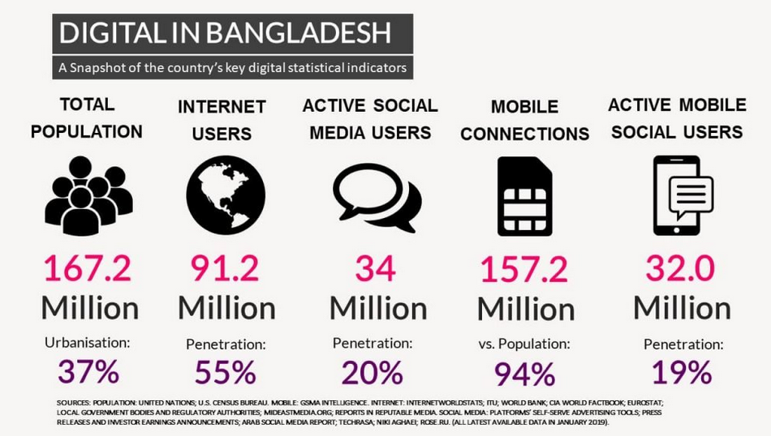
Motivation (Cont.)
A snapshot of the country’s key digital statistical indicators
Figure 1: A snapshot of the country’s key digital stat indicators.
Image Source : https://jmustafa.com/digital-in-bangladesh-2019/

Slide 8
Objectives
Containing around 6000 Bengali tech gadget reviews text documents.
Corpus Development
Annotate with two basic sentiment classes.
Annotation
Machine Learning based framework using Multinomial Naïve Bayes technique.
Model Development
Evaluate and compare the performance with other ML techniques.
Performance Evaluation

Slide 9



Challenges
No benchmark Bengali sentiment corpus on tourism reviews.
Labeling the data.
Lack of Hardware support.
Image Source: https://www.iconfinder.com/icons/1727405/data_document_document_document_database_document_file_document_storage_documentation_paper_sheet_icon
https://www.onlinewebfonts.com/icon/476249

Slide 10
Applications
Automated Tourism Review System
Customer Support and Feedback System
Tourist Place Monitoring & Reputation Management
Business Intelligence

Slide 11
Related Works
Sentiment Polarity Detection On Bengali Book Reviews Using Multinomial Naive Bayes [1] (Hossain et al., 2021)
The system can detect sentiment from any input Bengali text on book reviews.
Used traditional Machine Learning techniques.
Limitations:
Considered a small corpus of 2000 texts
Less accuracy – 84%.
References: [1] E. Hossain, O. Sharif, and M. Moshiul Hoque, “Sentiment polarity detection on bengali book reviews using multinomial naive bayes,” in Progress in Advanced Computing and Intelligent Engineering. Springer, 2021, pp. 281–292.

Slide 12
Related Works (Cont.)
Product Review Sentiment Analysis by Using NLP and Machine Learning in Bangla Language [2] (Shafin et al., 2020)
The system can detect sentiment from any input Bengali text on product reviews.
Used traditional Machine Learning techniques.
Limitations:
Considered a small dataset of 1020 texts.
Less accuracy.
References : [2] M. A. Shafin, M. M. Hasan, M. R. Alam, M. A. Mithu, A. U. Nur and M. O.Faruk, ‘Product review sentiment analysis by using nlp and machine learning in bangla language,’ in 2020 23rd International Conference on Computer and Information Technology (ICCIT), IEEE, 2020, pp. 1–5.

Slide 13
related Works (Cont.)
Sentiment Analysis Of Bengali Texts On Online Restaurant Reviews Using Multinomial Naïve Bayes [3] (Sharif et al., 2019)
The system can detect sentiment from any input Bengali text on restaurant reviews.
Used traditional Machine Learning techniques.
Limitations:
Worked with a small corpus of 1000 texts.
Less accuracy – 80.48%.
References: [3] O. Sharif, M. M. Hoque, and E. Hossain, “Sentiment analysis of bengali texts on online restaurant reviews using multinomial naïve bayes,” in 2019 1st International Conference on Advances in Science, Engineering and Robotics Technology (ICASERT). IEEE, 2019, pp. 1–6.

Slide 14
Related works (Cont.)
Sentiment Analysis on Product Reviews Using Machine Learning Techniques [4] (Jagdale et al., 2019)
The system can detect sentiment from any input English text.
Used Machine Learning approach.
Limitations:
Worked only for English texts.
Used only two ML models- Naïve Bayes & Support Vector Machine.
References: [4] R. S. Jagdale, V. S. Shirsat and S. N. Deshmukh, ‘Sentiment analysis on product reviews using machine learning techniques,’ in Cognitive Informatics and Soft Computing, Springer, 2019, pp. 639–647.

Slide 15
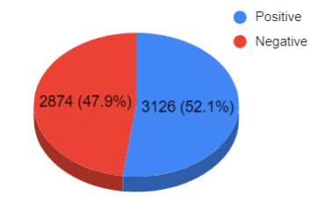
Corpus Analysis
Data Statistics
Figure 2 : Pie chart of data statistics.

Slide 16
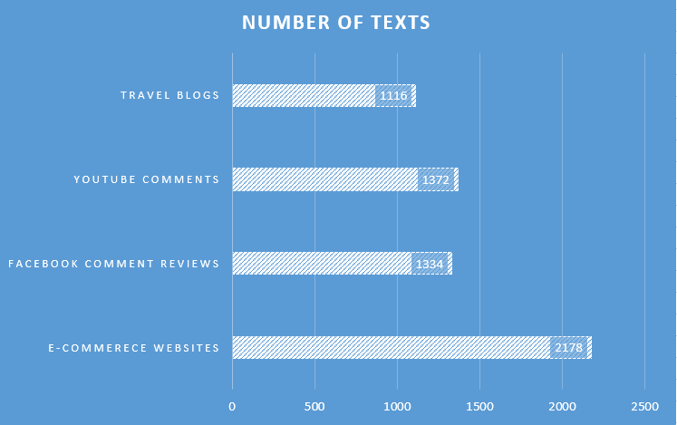
Corpus Analysis (Cont.)
Data Distribution
Figure 3: Bar chart of data distribution.

Slide 17
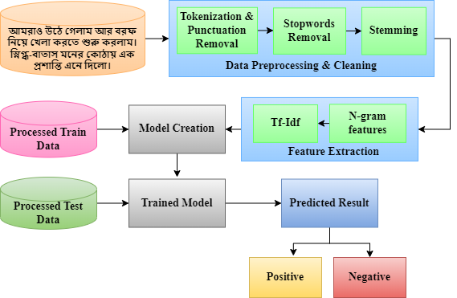
Methodology
Proposed Methodology
Figure 4 : Proposed methodology.

Slide 18
Experiment
Table 1 : Dataset splitting.
Phase | Data
Train | 4800
Test | 1200

Slide 19
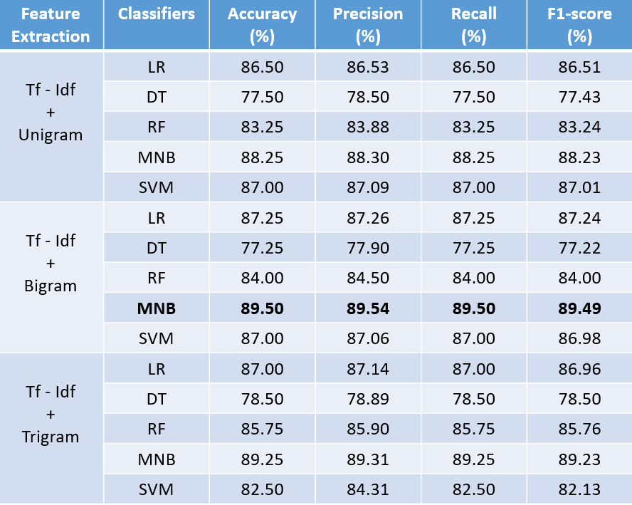
EXPERIMENTAL RESULTS
Tf-Idf Vectorizer + Ngram
Table 2 : Performance comparison among ML models for Tf-Idf.

Slide 20
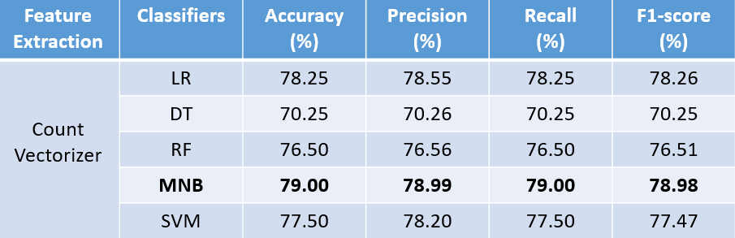
Experimental results (Cont.)
Count Vectorizer
Table 3 : Performance comparison among ML models for Count Vectorizer.

Slide 21
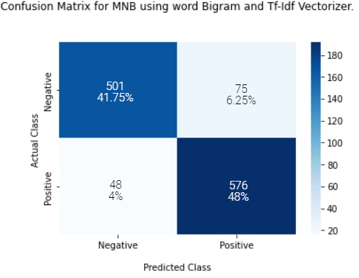
Error Analysis
Confusion Matrix
Figure 6: Multinomial Naive Bayes (Tf-Idf vectorizer and Bigram features)

Slide 22
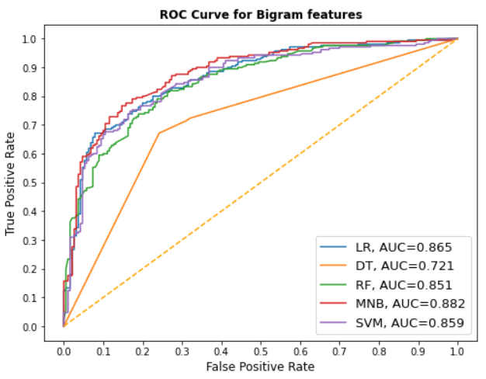
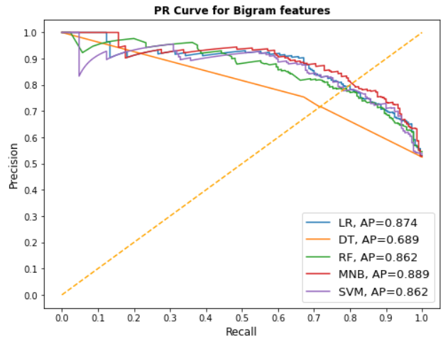
Error Analysis (Cont.)
ROC and PR Curve
Figure 7 : ROC curve for Bigram features.
Figure 8 : PR curve for Bigram features.

Slide 23
Limitations
Two classes are considered, more could be discovered.
Less Class
Due to less data.
Misclassification
Long training time.
Training Time

Slide 24
Future Improvements
More classes can be added.
Include more data on corpus.
Deep Learning models can be applied.

Slide 25
Conclusion
A lot of work has been done on sentiment analysis in English but we have poor support in Bengali.
An ML based model is developed that can classify Bengali text on tourism reviews into two basic sentiment classes.
The model we have proposed obtains maximum accuracy of 89.50% for Multinomial Naïve Bayes method along with Tf-Idf vectorizer feature extraction technique.
Our proposed model can assist in Customer Support and Feedback System as well as in Business Intelligence greatly.

Slide 26
References
[1] E. Hossain, O. Sharif, and M. Moshiul Hoque, “Sentiment polarity detection on bengali book reviews using multinomial naive bayes,” in Progress in Advanced Computing and Intelligent Engineering. Springer, 2021, pp. 281–292.
[2] M. A. Shafin, M. M. Hasan, M. R. Alam, M. A. Mithu, A. U. Nur and M. O.Faruk, ‘Product review sentiment analysis by using nlp and machine learning in bangla language,’ in 2020 23rd International Conference on Computer and Information Technology (ICCIT), IEEE, 2020, pp. 1–5.
[3] O. Sharif, M. M. Hoque, and E. Hossain, “Sentiment analysis of bengali texts on online restaurant reviews using multinomial naïve bayes,” in 2019 1st International Conference on Advances in Science, Engineering and Robotics Technology (ICASERT). IEEE, 2019, pp. 1–6.
[4] R. S. Jagdale, V. S. Shirsat and S. N. Deshmukh, ‘Sentiment analysis on product reviews using machine learning techniques,’ in Cognitive Informatics and Soft Computing, Springer, 2019, pp. 639–647.

Slide 27
THANK YOU

